Slide 1


Intro to
Programming
With python
iteration:
strings
Monday, February 24 2025 TOH210
Notes:
Layout objects pulled from: https://slidesgo.com/
All icons are from: https://thenounproject.com/

Slide 2
project reminders
All project work can be done with only material we have covered in class. Do not use concepts outside of what we cover in the slide decks. Any outside code will receive a 0.
Make sure to add a comment somewhere in the project if you received help from someone else (friends, TA, ect). This helps us understand how to project is going for folks in our classroom.

Slide 3

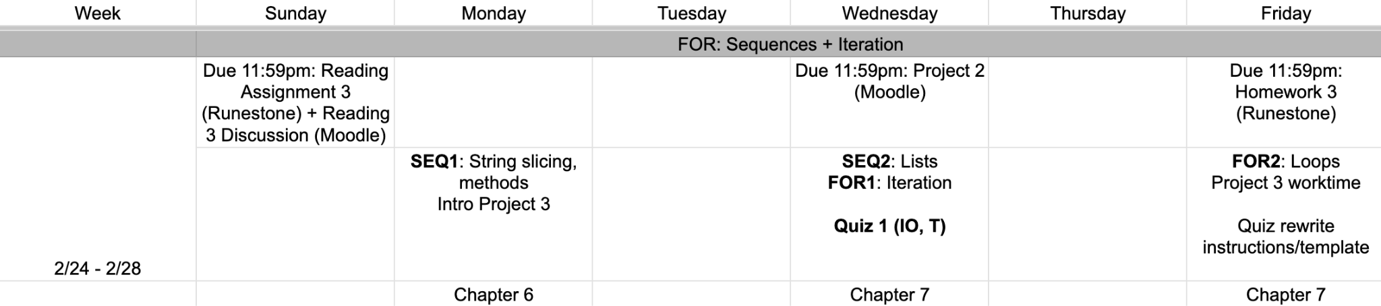
This week
google sheet link

Slide 4
colab workbook
click for access
found on Moodle under this week

Slide 5

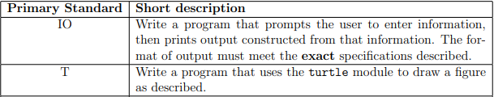
this Wednesday!
Quiz 1
All information about these are in the Standard IO and Standard T handouts up on Moodle

Slide 6
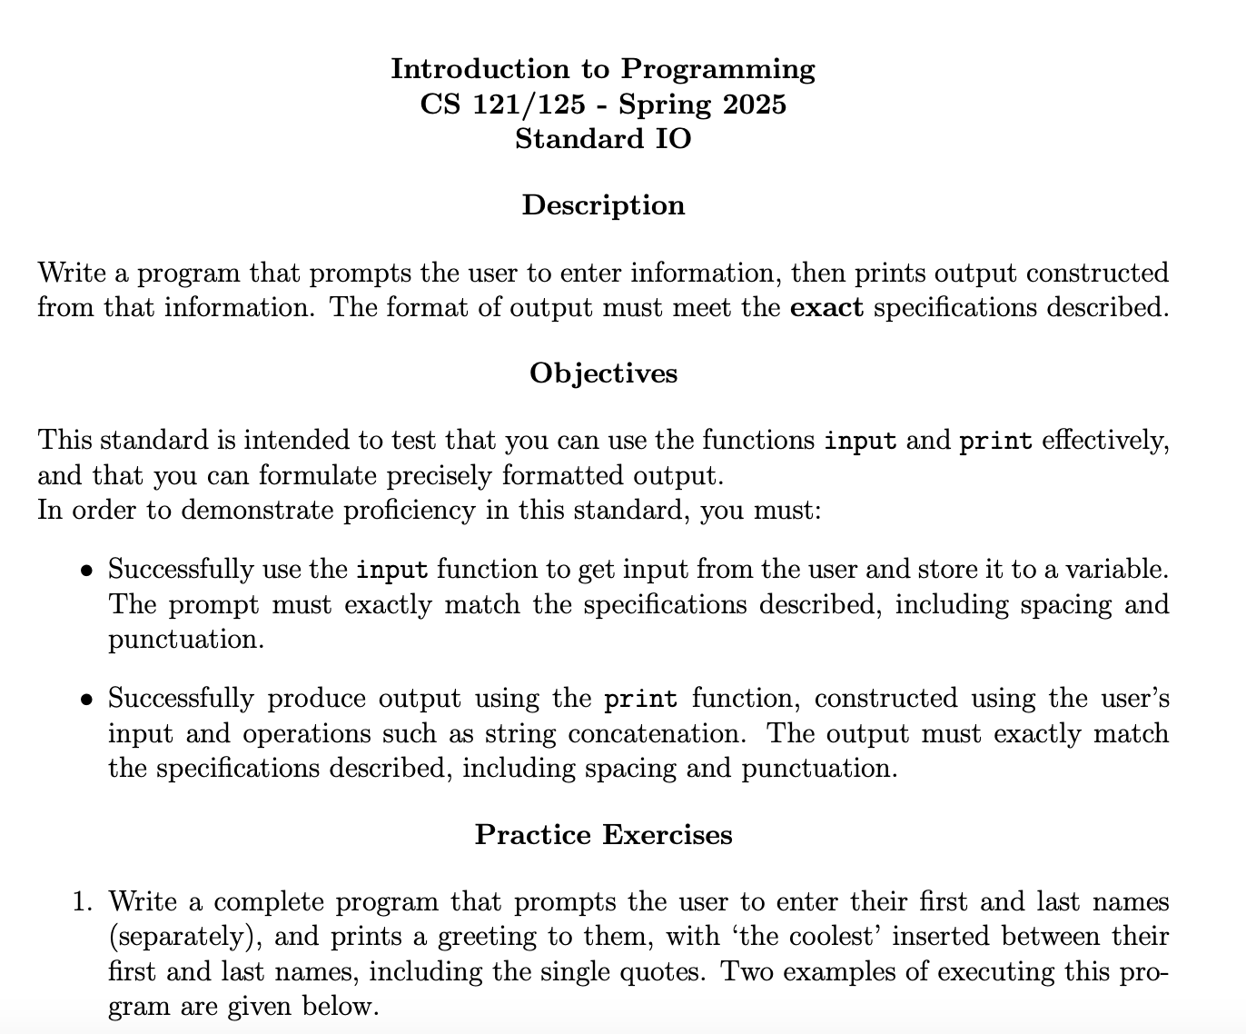
this Wednesday!
standard IO
click here to view

Slide 7
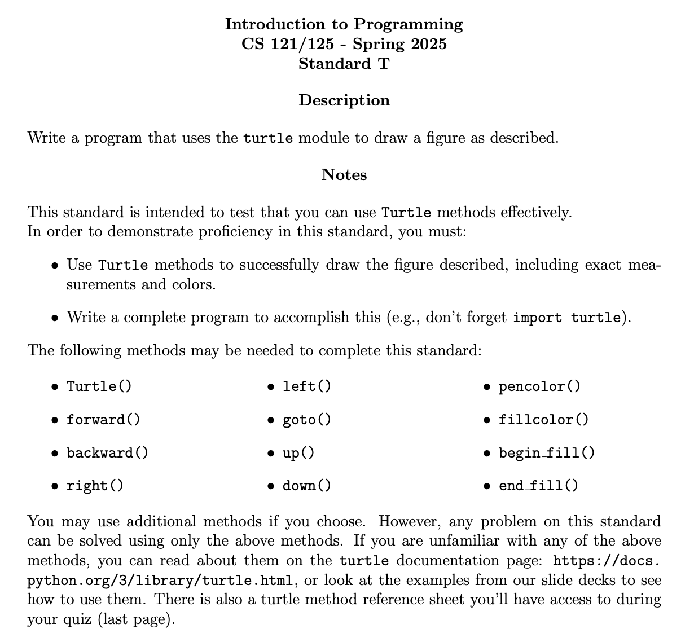
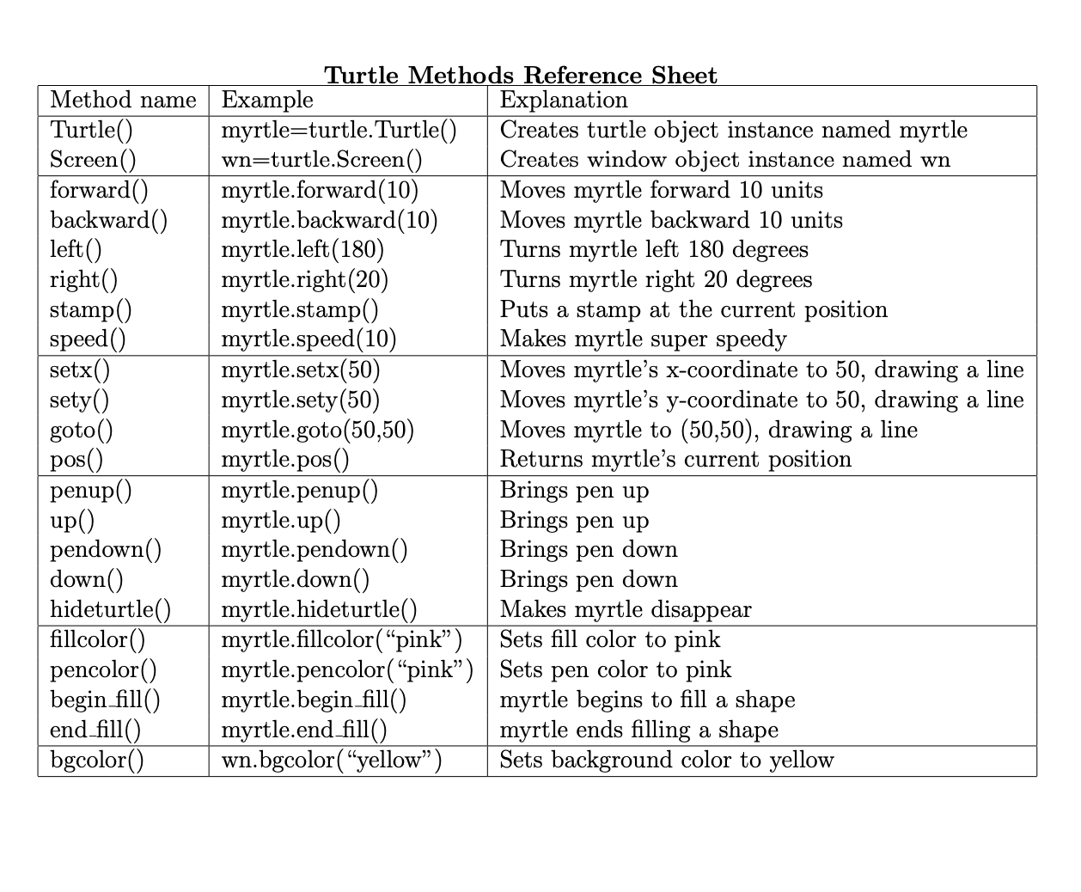
this Wednesday!
standard t
click here to view

Slide 8
How quizzes are graded
For each of the two standards, you will receive one of three grades:
P - you have full credit for this standard.
R - your solution has a minor error.
If you submit a correct revision to your solution by Monday 3/3 (no extensions possible), this will change to an P
If you submit an incorrect revision or no revision, this will change to an I
I - you do not yet have credit for this standard. You will be able to reattempt it on Exam I.
if you miss the quiz(no matter the reason) you will receive an I and need to retake during Exam I.

Slide 9


WARMUP
sequences of numbers
Write for loops to print the following sequences of numbers where each number is printed on a new line.
-10, -5, 0, 5, 10, 15
0, 2, 4, 6, 8, 10
10, 9, 8, 7, 6, 5, 4, 3, 2, 1
for _ in range(-10, 16, 5):
print(_)
for _ in range(0, 11, 2):
print(_)
for _ in range(10, 0, -1):
print(_)

Slide 10
Takeaways from last time
Things you should know:
terminology: class, instance, method
options for the range function
string indexing

Slide 11
we index by starting at 0 and increasing by one as we move left to right
text = “KOWABUNGA!”
0 1 2 3 4 5 6 7 8 9
kowabunga!
We can think of a string as a sequence of characters
-10 -9 -8 -7 -6 -5 -4 -3 -2 -1
We can access individual characters with indexing
we can reverse our indexing by starting at -1 and increasing by one as we move right to left
text[0] → “K”
text[-1] → “!”
text[10] →
IndexError: string index out of range
text[-5] →
text[4] → “B”
“U”

Slide 12
text = “KOWABUNGA!”
0 1 2 3 4 5 6 7 8 9
kowabunga!
We can access several consecutive characters with slicing
one option:
text[4] + text[5] + text[6] → “BUN”
better option:
text[4:7] → “BUN”
start at index 4, go up to (but do not include) index 7
start
stop
through
“up to”
Let’s look at more ways to slice this string

Slide 13
text = “KOWABUNGA!”
0 1 2 3 4 5 6 7 8 9
kowabunga!
We can access several consecutive characters with slicing
text[4:7] → “BUN”
start at index 4, go up to (but do not include) index 7
text[4: ] → “BUNGA!”
end
start at index 4, go to the end of the string
text[ :4] → “KOWA”
beginning
start at beginning of the string, go up to (but do not include) index 4
beginning
text[:-1] → “KOWABUNGA”
last character
start at beginning of the string, go up to (but do not include) the last character
end
text[-3:] → “GA!”
last three characters

Slide 14
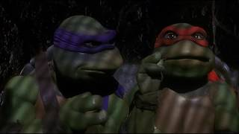

Slide 15

practice
pizza party
Let’s practice! Use the following quote to create the following sayings:
quote = "Forgiveness is divine, but never pay full price for late pizza."
Forgiveness is pizza.
divine pizza
never ever
pay later
quote[:15] + quote[-6:]
quote[15:21] + quote[-7:-1]
quote[27:33] + quote[28:32]
quote[33:37] + quote[-11:-7] + quote[-13]

Slide 16
We may find it helpful to know how long a string is when using slicing.
To do this, we use the len function
music = “yellow mellow cello”
len(music)
→ 19
The len function will return the length of the string music

Slide 17
strings have methods too!
music = “yellow mellow cello”
music.count(‘l’) → 6
the method count() counts and returns the number of occurrences of a substring. If there is no occurrence of the substring, count returns 0.
music.count(‘ello’) → 3
music.count(‘x’) → 0
music.index(‘l’) → 2
the method index() finds and returns the index of the first occurence of the substring. If there is no occurrence of the substring, index throws an error.
music.index(‘ello’) → 1
music.index(‘x’) → ValueError
music.find(‘l’) → 2
the method find() finds and returns the index of the first occurence of the substring. If there is no occurrence of the substring, index returns -1.
music.find(‘ello’) → 1
music.find(‘x’) → -1
we’ll cover split + join methods for strings next class

Slide 18
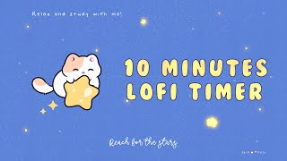
Exercise
name check
Write a program that prompts the user to enter their full name. The program splits this into their first and last name, and prints these separately.
Enter your full name: Pippin Took
Your first name is Pippin.
Your last name is Took.
Key Steps:
find the location of the space
use string slicing to get their first and last name

Slide 19

before next time
Finish workbook
Good start on task 3 Project 2
Look at Standards IO + T & do practice problems

Slide 20
going over Check Your Understanding from section 7.7
becomes range(6) since length of our string s is 6
for loop: idx grabs values one-by-one from our range function and “temporarily” gets assigned those values
s = "python"
for idx in range(len(s)):
print(s[idx % 2])
6
we use string indexing to find the character in our string s with index calculated by the expression idx % 2
The first time the for loop will have idx grab the value 0, then will display s[0%2] →s[0] →”p”
Notice, any even number % 2 will always be 0, so “p” will be displayed.
Likewise any odd number % 2 will always be 1, so “y” will be displayed.
The second time the for loop will have idx grab the value 1, then will display s[1%2] →s[1] →”y”
The third time the for loop will have idx grab the value 2, then will display s[2%2] →s[0] →”p”
This repeats until idx gets to the value of 6, and the for loop ends

Slide 21
When would we need string indexing + methods?
Anytime you want to take what the user inputs and manipulate it in any way.
Anytime you want to deal with text data (which if you continue on in CS is a lot!)
Depending on the field you go into (genomics, bioinformatics, linguistics, data science)

